Slide 1

THIAGARAJAR COLLEGE OF ENGINEERING
GAS LEAKAGE MONITORING SYSTEM
Team Members:
Mahalakshmi C - 19D047
Raji Santhoshi T G - 19D070
Laila B G - 19D043
Durga Devi G - 19D117

Slide 2
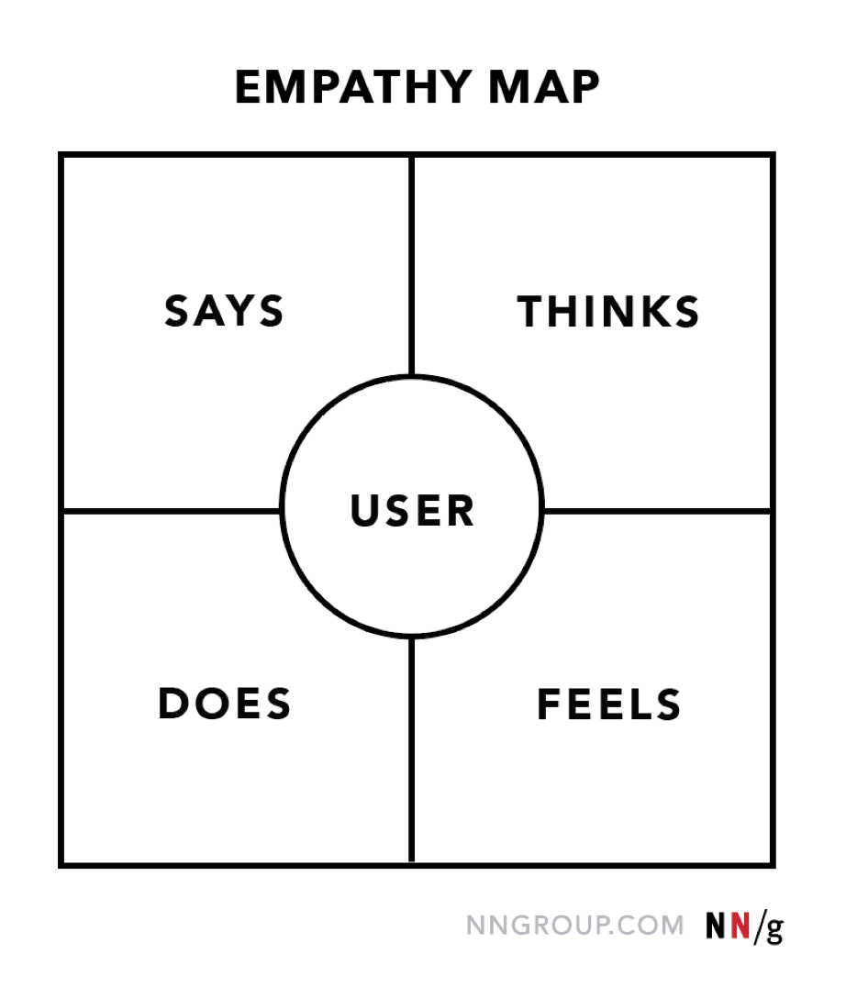
EMPATHY MAP
Empathy Map Structure:

Slide 3
Empathy map for Gas Leakage Monitoring System:
The gas can leakages unfortunately. | Gas leakage can be sensed by using sensors.
The Gas Leakage can be recognized by sensors, and the buzzer will generate an alert sound. | The user knows the leakage of the gas when the buzzer produce the sound.
User

